Slide 1
Personalised Meal Planner

Slide 2
TEAM DETAILS
A YASHWANTH - 99220041035 B VIKRAM - 99220041121 A HARSHITHA - 99220041108 AVL HARSHINI - 99220041058 D SAMMERAH - 99220041040

Slide 3
Introduction
Problem:
Individuals often face hurdles in planning meals that keep pace with their nutrition demands while also feeding into health conditions or fitness goals . Currently available meal planners miss out on personalisation and integration with nutrition analysis.
Solution:
It is a meal planner and recipe generator that creates recipes that are downloaded per the software user's nutritional requirements, preferences, and health issues by using artificial intelligence.

Slide 4
OBJECTIVES
1 .Design a smart personalized meal planner.
2 .Enable real-time nutrition analysis for each meal.
3 .Include an AI recipe generator based on available ingredients.
4 .Offer health insights and user progress tracking.
5 .Provide a user-friendly interface with a mobile app for convenience.

Slide 5
TARGET USERS
1 .Health-conscious groups
2 .Fitness followers (gym-goers, sports)
3 .Diet-conscious individuals (diabetic, gluten-free, keto, vegans, etc.)
4 .Busy professionals and their families
5 .Elderly individuals with balanced diets.

Slide 6
KEY FEATURES
1 .Meal preparation customized (For user preferences and health goals)
2 .Nutritional Analysis (Tracks calorie, protein, carbohydrate, and vitamin values)
3 .Recipe Generator (Makes suggestions for meals based on ingredients available at home.)
4 .It merges health metrics by synchronizing them with health data from fitness apps.
5 .Shopping List Generator (Provides based on planned meals grocery lists.)
6 .Synergistic with user habits and preferences.

Slide 7
BENFITS
1 .Saves Time – No more manual meal planning.
2 .Improves Nutrition – Balanced diet is ensured.
3 .Health Tracking – Progress can be monitored.
4 .Cost-efficient – It will save on food wastage through consumption of available ingredients.
5 .Diet Customization – For weight loss, muscle gain, or medical purposes.

Slide 8
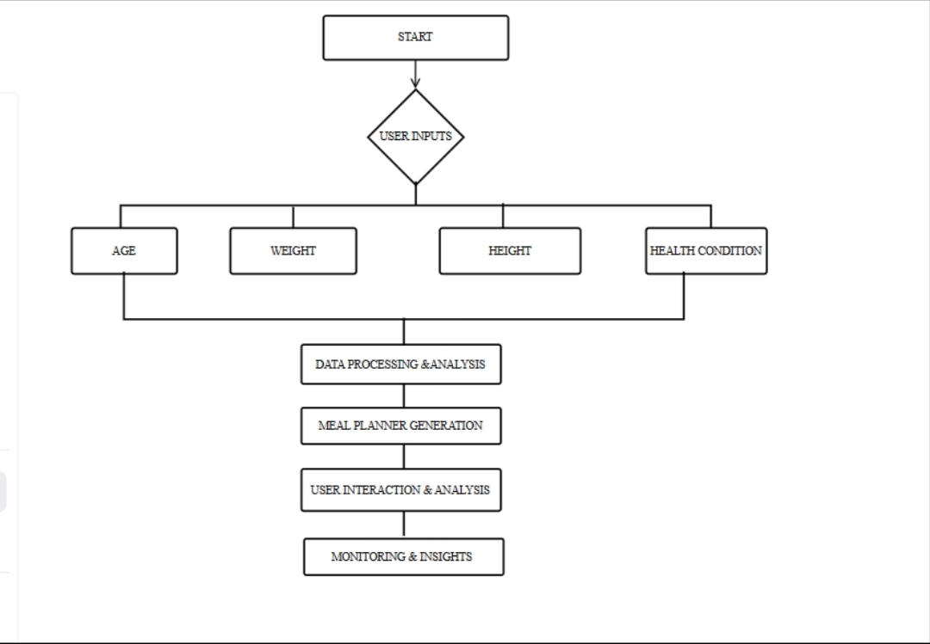
FLOW CHART

Slide 9
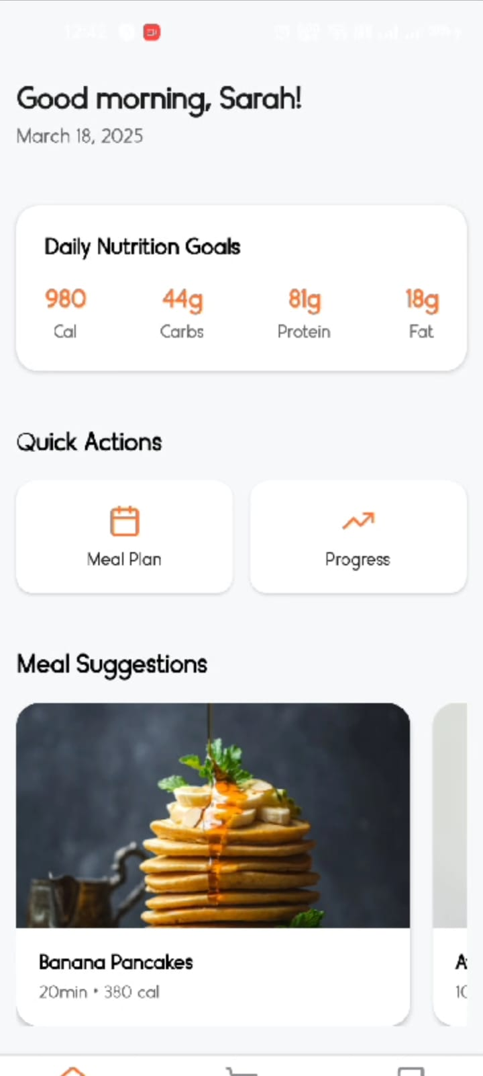
Recipe Generator Functionality
The Recipe Generator of MEAL PLANNER & NUTRITION TRACKER App was created to allow users to find personalized meals according to available ingredients and dietary preferences. Once ingredients are keyed into the system, intelligent algorithms vastly propose a myriad of recipes that resonate with dietary goals. Each recipe comes with a comprehensive ingredient list as well as stepwise instructions, and a calorie, protein, and carbohydrate breakdown per serving. The functionality also includes quality images and short descriptions to guide the user in making wise choices. Users can read through some other alternative recipes, save favorites, and easily integrate selected meals into the daily meal planner. It makes meal prep more effective and lowers waste while helping users sustain a balanced diet .

Slide 10
RECIPE GENERATOR
Search by ingredients:
1 .Users enter available ingredients.
2 .AI proposes recipes based on selected ingredients.
Recipe recommendations:
1 .Offers meal options along with pictures and short descriptions.
2 .Provides caloric and macronutritional breakdowns (Calories, Proteins, Chicken).

Slide 11
GROCERY
Auto-Generated Grocery List:
Configured based on the selected meal plans.
Categorized into sections such as Protein, Produce, Pantry.
Checklist is handy for:
Marking items purchased by the user.
Minimizing chances of forgetting an ingredient.
Icon for a Camera:
perhaps scanning items or adding custom items.
Then a button would appear: "Mark All as Done":
That helps users maintain a list of completed shopping tasks.

Slide 12
User profile & settings
Dietary Preferences:
Vegan, Keto, Low-Carb, High-Protein, etc.
Health Goals:
Weight loss, muscle gain, balanced nutrition.
Saved Recipes & Meal Plans:
Users will save their favorite meals in their settings to revisit at a different time.

Slide 13
UI/UX FEATURES

Slide 14
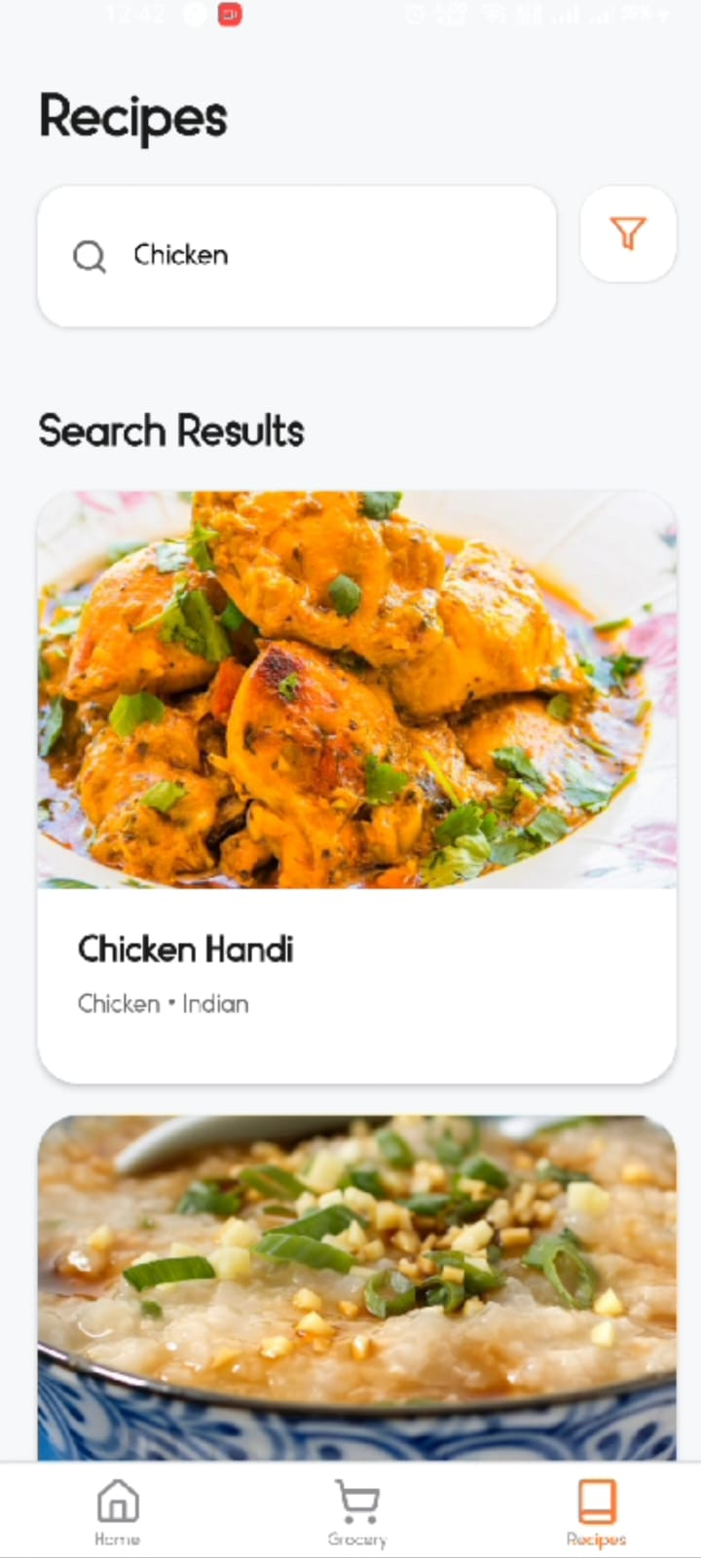
Custom meal suggestions, according to fancy.
Beautiful Picture-quality arrangement and layout.
Easy Navigation- Bottom menu instant access.
Suggest Recipes to Ingredients - Reduce Waste.
Calorific and Macronutrient Detail.

Slide 15

Testing and Quality Assurance
This app for meal planning and nutrition tracking is put through detailed quality assurance and functional testing before being made available for users. All parts of the app, including the meal planner itself, recipe generator, and shopping list, are tested for completeness, responsiveness, and the ease with which the user can utilize them instead of downloading the entire package. The application is validated on many different devices and screen sizes so that it gives a consistent and intuitive user interface. The prime tests include ingredient-wise recipe generation accuracy, real-time meal customization, and shopping list automation. Performance testing ensures the minimal load time, while security checks are meant to protect the user's data. Beta testing is also conducted for the user incorporation of feedback into improving functionality and usability. This comprehensive approach guarantees that the application is high quality, without errors, meets all user expectations, and ensures a seamless and effective experience in meal planning..

Slide 16
CHALLENGES & SOLUTIONS
User acquisition - Add a free demo as well as handy onboarding
Nutritional precision- Incorporate credible nutrition APIs
Diet variety- Broaden database for international cuisines
Food allergies tackling- Sophisticated filtration options

Slide 17
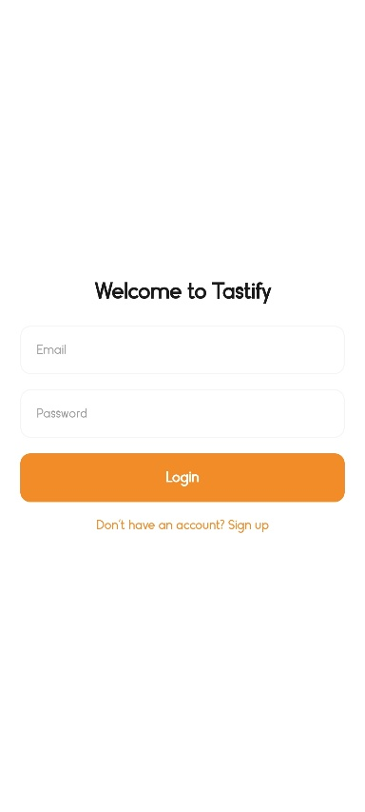
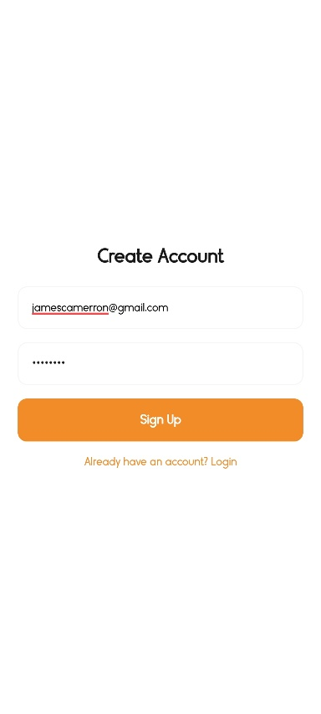
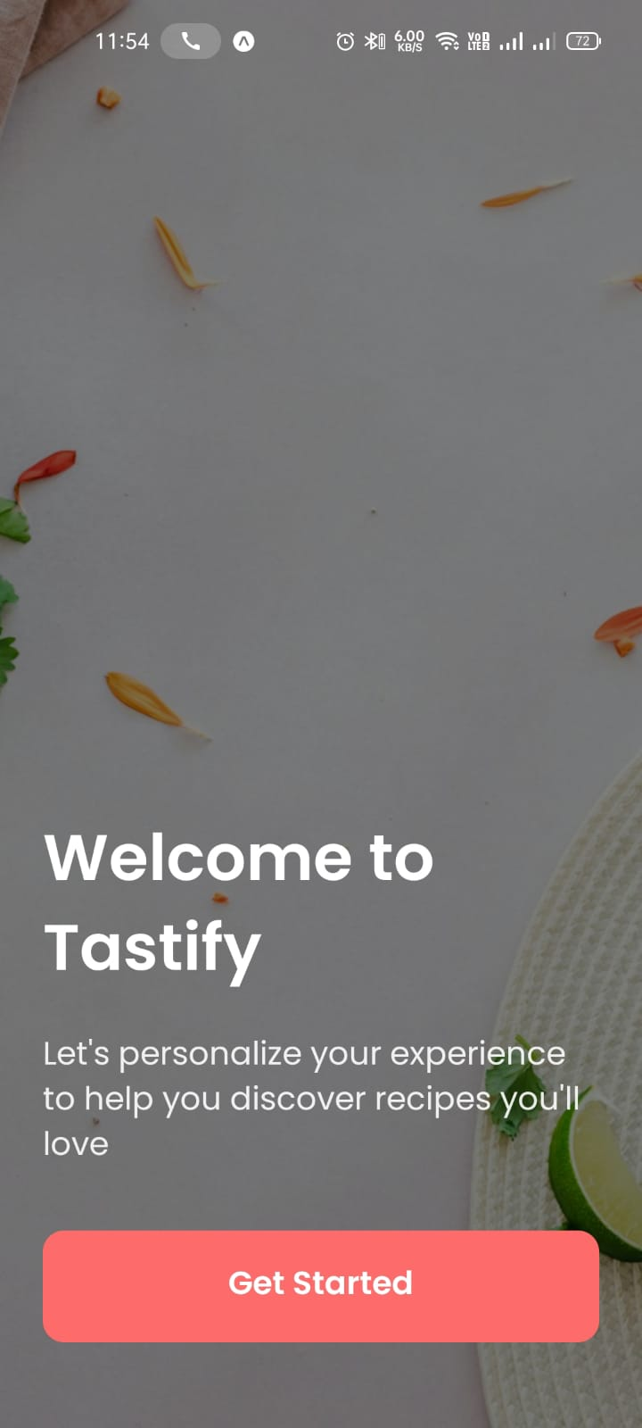
APP INTERFACE

Slide 18
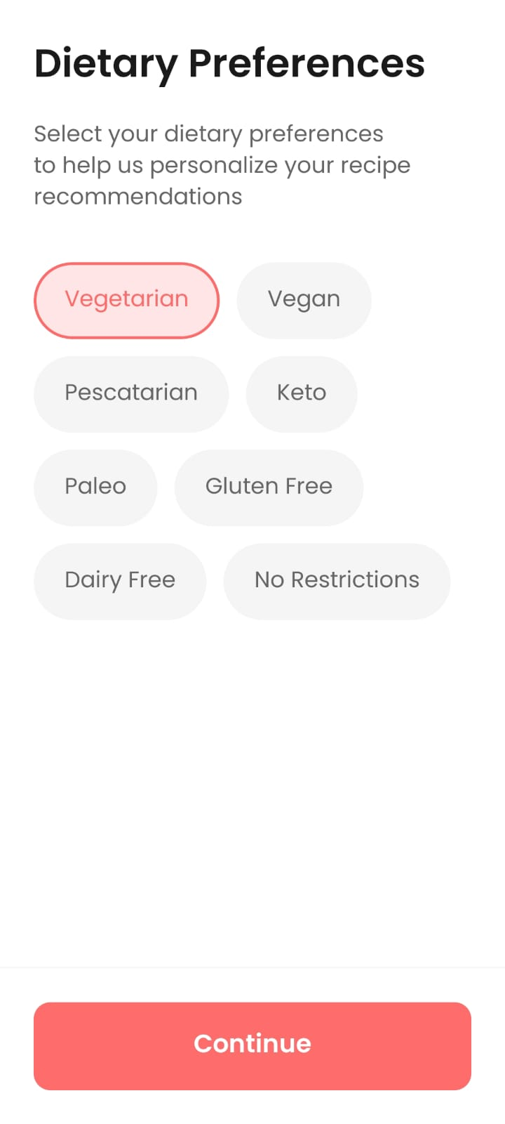
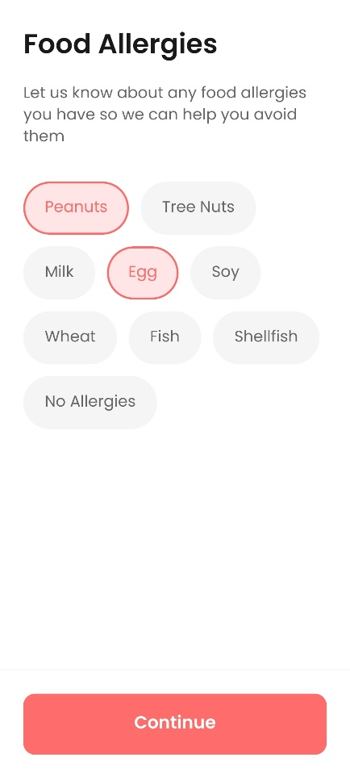
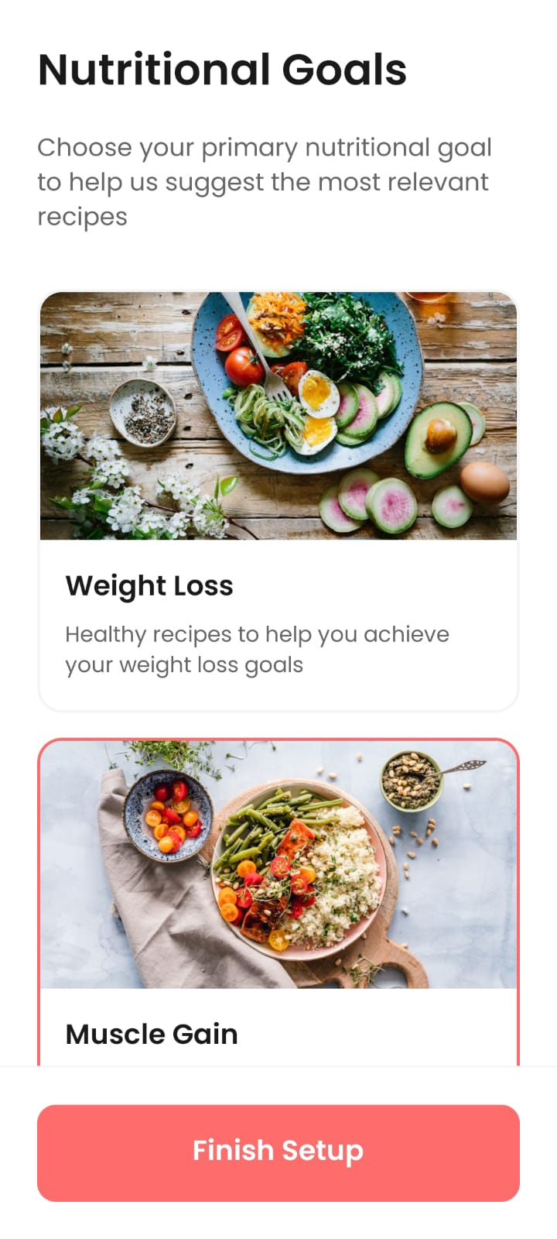
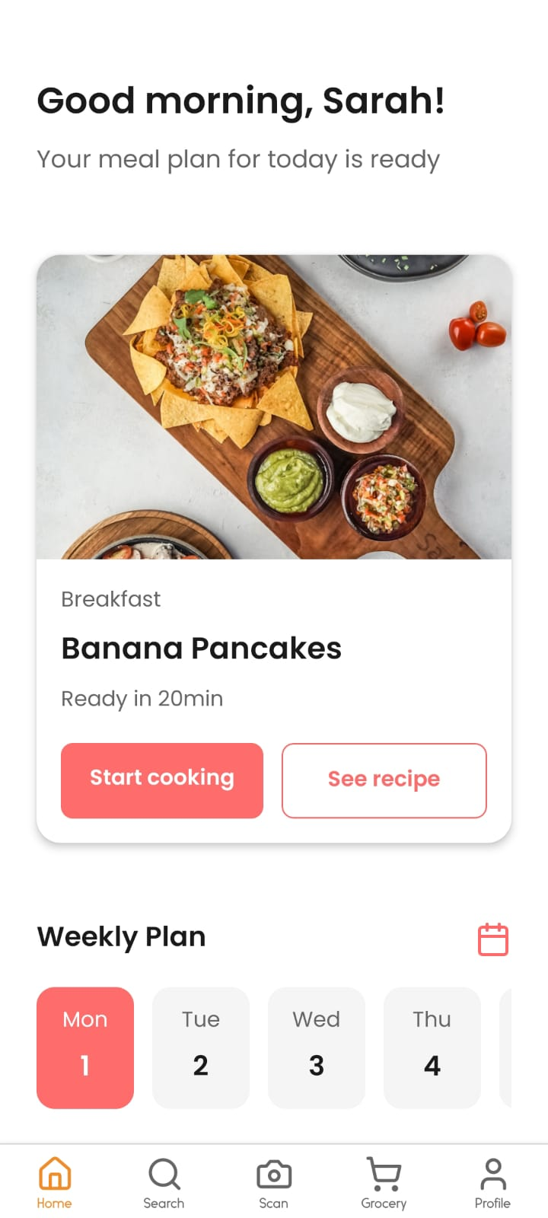

Slide 19
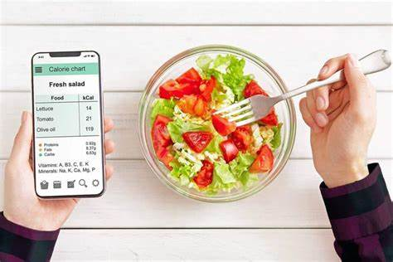
Conclusions
The MEAL PLANNER app simplifies meal planning by offering personalized recipes, automated shopping lists, and nutrition tracking. With its user-friendly interface and smart features, it helps users save time, reduce food waste, and maintain a healthy diet. By integrating automation and customization, the app ensures a seamless and efficient meal planning experience.

Slide 20
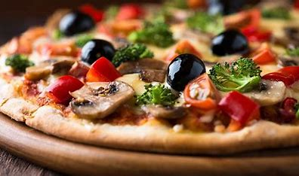
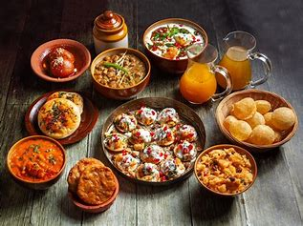
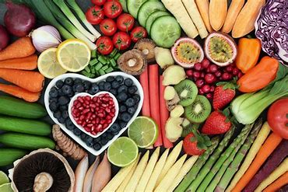


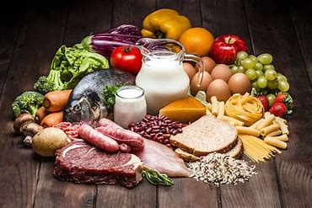
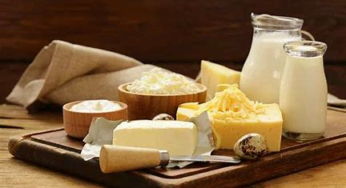

THANK YOU😊

